Slide 1
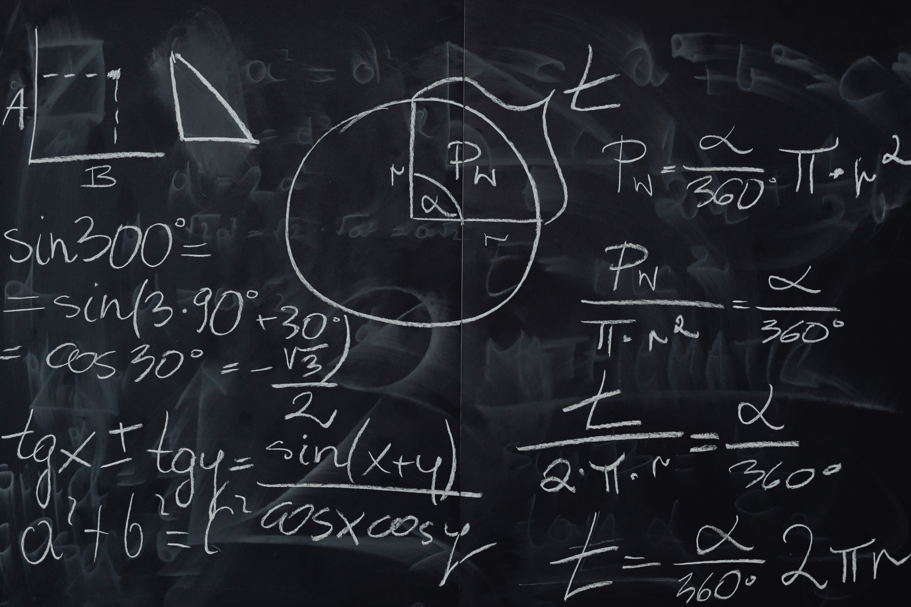
KALMAN FILTER
practical princuples & usage
and a little math

Slide 2

what is kalman filter?
why is it useful?
today’s focus :
when and how to use kalman filter?
how kalman filter works?
(intuition & math)

Slide 3
WHAT IS KALMAN FILTER?
Kalman filter is a smart math formula. It provides an estimate of the system's state and their uncertainty values.
It works in steps by estimateing the next state and then fixing that estimation using new data.

Slide 4
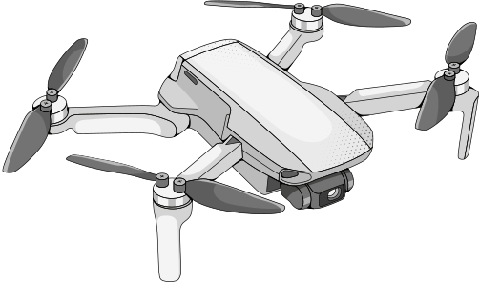
EXAMPLE
  prediction
  observation
  calculations

Slide 5
noise removal
why is kalman filter usefull?
sensors combination
Fast and light

Slide 6
WHEN TO USE KALMAN FILTER?
Kalman filter is usefull when you need to estimate hidden internal states of a dynamic system using a series of noisy, indirect, or incomplete measurements
in simpler words: we use kalman filter when we need to determine the current state of a system based on the previous estimated states, unaccurate data and calculations.

Slide 7
HOW KALMAN FILTER WORKS?
intuition
kalman filter calculates a prediction of the next state based on the current and previous states. after that it calculates the difference between the predicted observation that would lead to the predicted next state, and the real observation. them it decides how relible is the prediction and how relible is the observation and determins the next state.
in case there are more than one observation at each time we do the same proccess foe all of them - estimating the next state based on one observation than moving to the next one.

Slide 8
HOW KALMAN FILTER WORKS?
math

Slide 9
HOW KALMAN FILTER WORKS?

Slide 10
HOW TO USE KALMAN FILTER
Define matrices: Set up state transition (F), measurement (H), process noise covariance (Q), and measurement noise covariance (R) matrices.
Initialize: Set a starting guess for state x and error covariance P.
Loop in code: Run the predict and update equations sequentially in a real-time loop for every new sensor reading.
Tune parameters: Adjust Q and R values based on how much you trust your process model versus your physical sensors

Slide 11


EXTENDED KALMAN FILTER
the nonlinear version of the Kalman filter which linearizes about an estimate of the current mean and covariance

Slide 12
channel estimation
usage examples of kalman filter
noise filtering
tracking phase & frwquncy of a signal

Slide 13

TO SUM UP
we learned what is the kalman filter, why and when we should use it
we learned how to use the kalman filter and why it works

